Slide 1


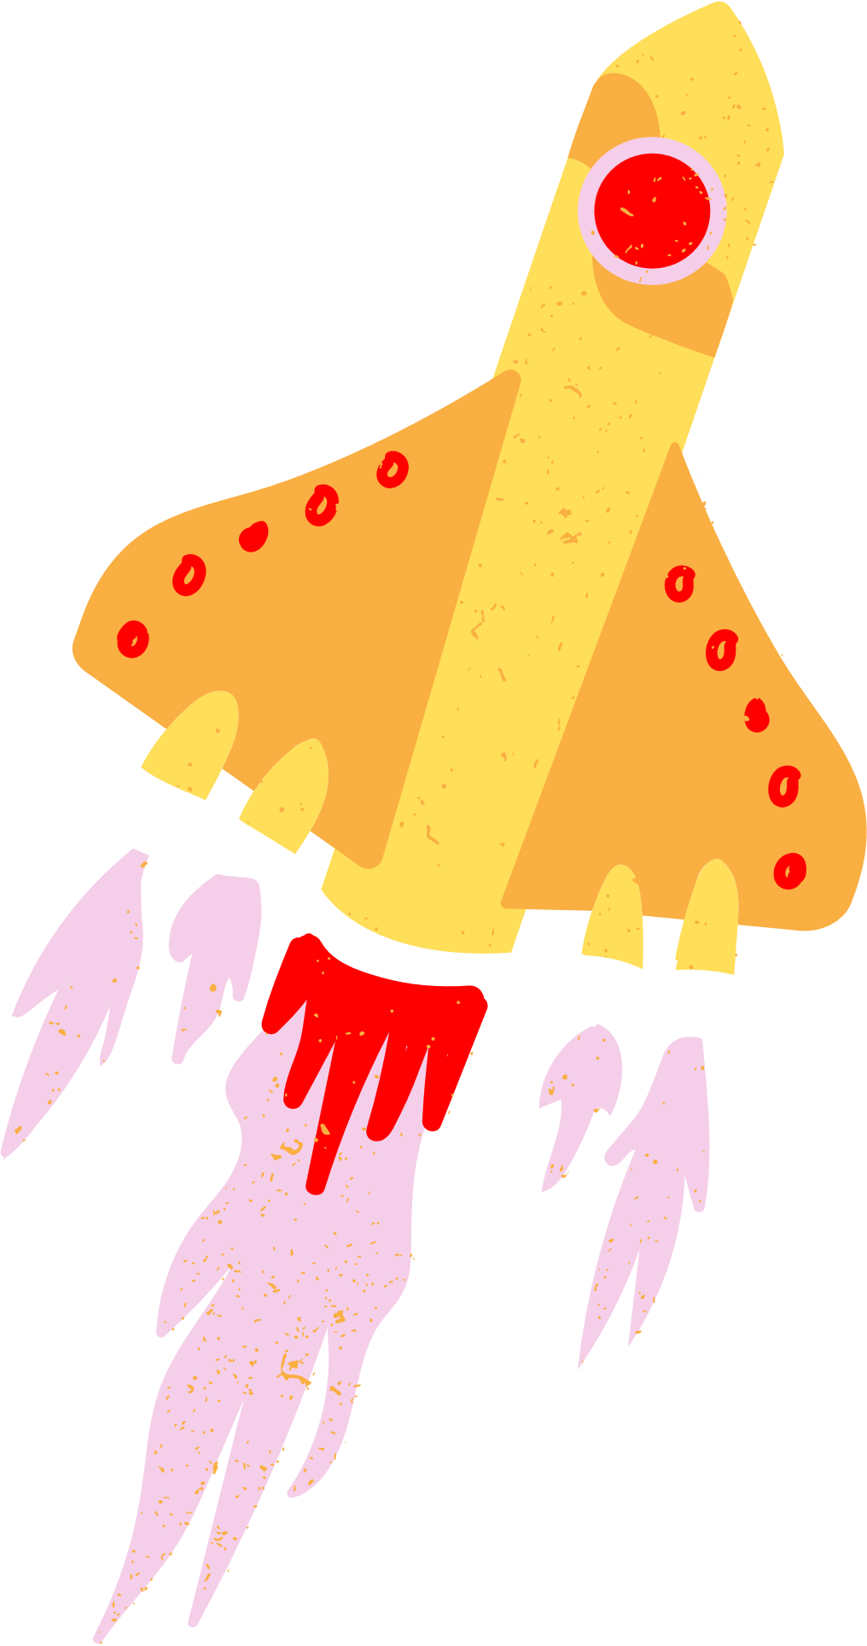


InSar challenge detectives
Differential InSar techniques to analyze rapidly changing terrain
GNU/Linuxers

Slide 2
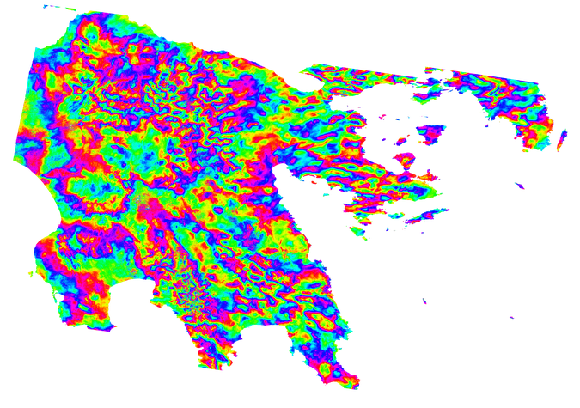
What is our challenge?
Our challenge was to come up with an algorithm to remove the tropospheric signal, wihich produces noise, form various radar datasets so the resulting signal can be used to study small deformations of the Earth's surface
We chose this challenge because we liked the idea of working with signals and representing different parts of the Earth's surface. Furthermore we thought it was an interesting challenge and that it had an useful application

Slide 3

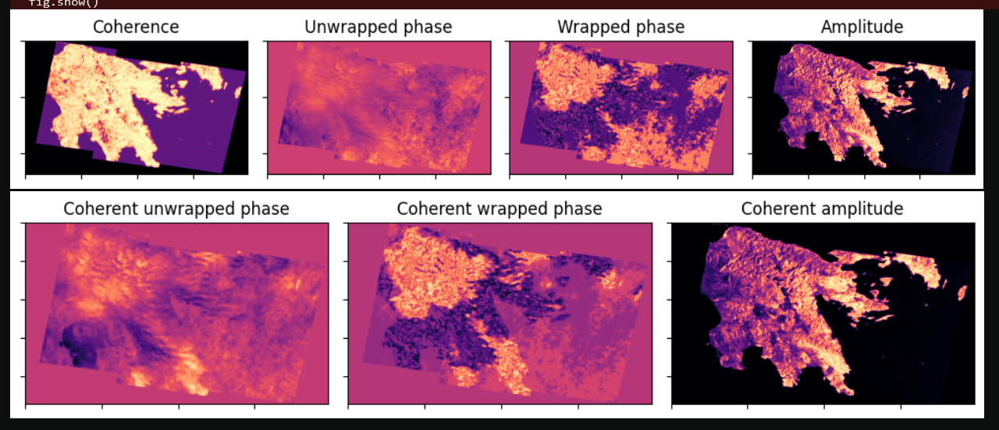
The begginings

Slide 4


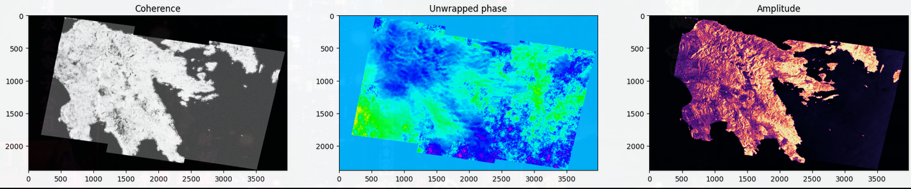

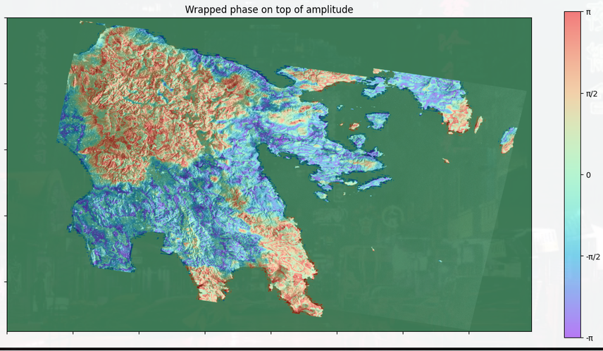
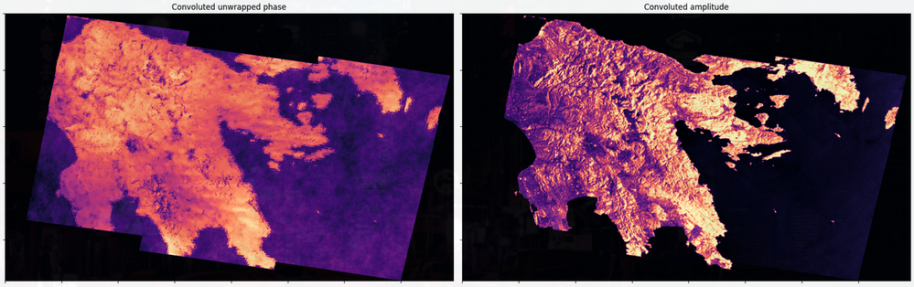

Filter process
Raw data
Interferogram
Coherent data
Filtering

Slide 5
Algorithms
We implemented the convolution algorithm that reduces the noise in the image making an average weighted by the kernel points.
Using a kernel calculated with the exponential function we get a good reduction of noise without losing too much data.
Some algorithms we used are:
Convolution algorithm
Convolution algorithm with kernel
Frost's algorithm
Space-time filtering algorithm**
The usual time filtering methods from InSAR are not suitable for our problems, since the assume constant data over time**

Slide 6
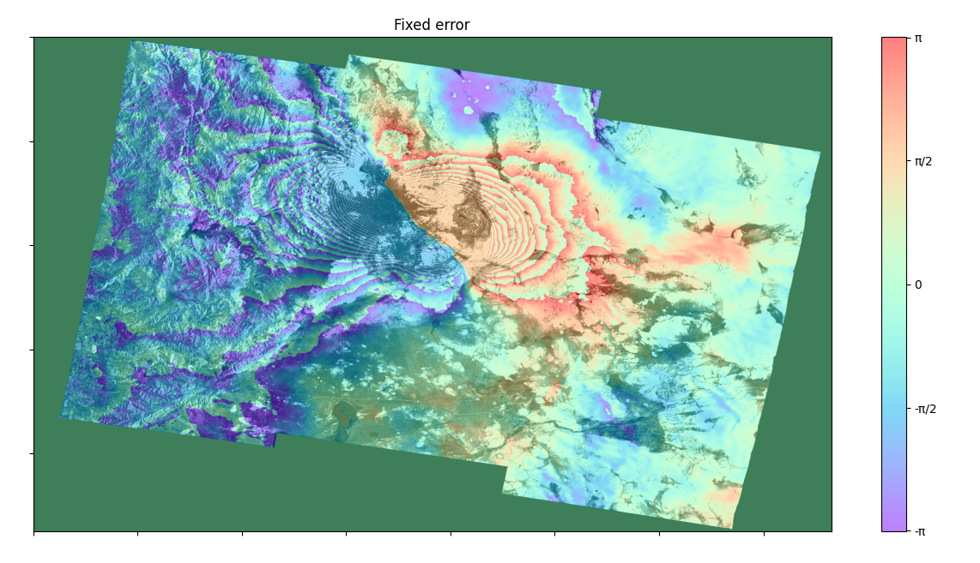

Slide 7

Bibliography
Synthetic Aperture Radar Land Applications Tutorial, {“https://earth.esa.int/documents/10174/2700124/sar_land_apps_1_theory.pdf", by ESA, UNESCO Bilko, sarmap}
ASF Sentinel-1 (S1) InSAR Dataset {"https://search.asf.alaska.edu/#/?dataset=SENTINEL-1%20INTERFEROGRAM%20(BETA)"}

